Slide 1
EMTH403
Mathematical Foundation for Computer Science

Slide 2
Lecture Outcomes
understand what is graph coloring.
understand what is a 4-Color Map Theorem.
understand what is a chromatic number

Slide 3
Coloring Graphs
Definition: A graph has been colored if a color has been assigned to each vertex in such a way that adjacent vertices have different colors.
Definition: The chromatic number of a graph is the smallest number of colors with which it can be colored.
In the example above, the chromatic number is 4.

Slide 4
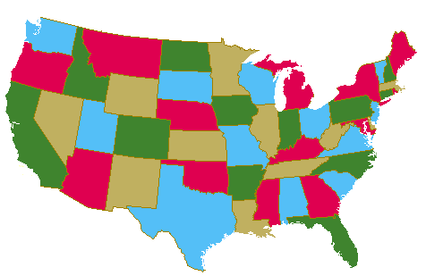
Coloring Graphs
Four colors are sufficient to color a map of the contiguous United States.
Source of map: http://www.math.gatech.edu/~thomas/FC/fourcolor.html

Slide 5
Coloring Graphs - Trees
root
Pick any vertex as “root.”
if (unique) path from root is
even length:
odd length:

Slide 6
Coloring Graphs - Trees
What is the chromatic number for each of the following graphs?
White
White
Yellow
Green
Yellow
Yellow
White
White
Yellow
Yellow
White
Chromatic number: 2 Chromatic number: 3

Slide 7
Coloring Graphs - 2-Colourable Graphs
When exactly is a graph 2-colourable?
This is 2-colourable.
2 colourable: tree, even cycle, etc.
Not 2 colourable: triangle, odd cycle, etc.

Slide 8
Coloring Graphs - Bipartite Graphs
When exactly is a graph 2-colourable?
Is a bipartite graph 2-colourable?
Is a 2-colourable graph bipartite?
Fact. A graph is 2-colourable if and only if it is bipartite.

Slide 9
Coloring Graphs –
Application in Exam Scheduling
Suppose that in a particular quarter there are students taking each of the following combinations of courses:
Math, English, Biology, Chemistry ,
Math, English, Computer Science, Geography
Biology, Psychology, Geography, Spanish,
Biology, Computer Science, History, French

Slide 10
Coloring Graphs –
Application in Exam Scheduling
What is the minimum number of examination periods required for the exams in the ten courses specified so that students taking any of the given combinations of courses have no conflicts?

Slide 11
Coloring Graphs –
Application in Scheduling
Twelve faculty members in a mathematics department serve on the following committees:
Undergraduate education: Sineman, Limitson, Axiomus, Functionini
Graduate Education: Graphian, Vectorades, Functionini, Infinitescu
Colloquium: Lemmeau, Randomov, Proofizaki
Library: Van Sum, Sineman, Lemmeau
Staffing: Graphian, Randomov, Vectorades, Limitson
Promotion: Vectorades, Van Sum, Parabolton

Slide 12
Coloring Graphs –
Application in Scheduling
The committees must all meet during the first week of classes, but there are only three time slots available.
Find a schedule that will allow all faculty members to attend the meetings of all committees on which they serve.

Slide 13
Coloring Graphs – Chromatic Number
Find the chromatic number of the given graph.
Since there is a triangle, at least 3 colors are needed. Clearly 3 colors suffice, since we can color a and d the same color.

Slide 14
Coloring Graphs – Chromatic Number
Find the chromatic number of the given graph.
Since there is a triangle, at least 3 colors are needed. Clearly 3 colors suffice, since we can color a and c the same color.

Slide 15
Coloring Graphs – Chromatic Number
Find the chromatic number of the given graph.
Since there is a triangle, at least 3 colors are needed. Clearly 3 colors suffice, since we can color a and c the same color.

Slide 16
Coloring Graphs – Chromatic Number
Find the chromatic number of the given graph.
Since there is an edge, at least 2 colors are needed. The coloring in which b, d, and e are red and a and c blue shows that 2 colors suffice.

Slide 17
Coloring Graphs – Chromatic Number
Find the chromatic number of the given graph.
Since there is a triangle, at least 3 colors are needed. It is not hard to construct a 3-coloring. We can let a, f, h, j, and n be blue; let b, d, g, k, and m be green; and let c, e, i, l, and o be yellow.

